Slide 1
Architectural Tactics and Patterns
张严辞

Slide 2
Outline
Introduction
Typical patterns
Relationships between tactics and patterns
Using tactics together

Slide 3
Outline
Introduction
Typical patterns
Relationships between tactics and patterns
Using tactics together

Slide 4
Introduction 1/2
How to design the following software?
I want to construct a complex software system that is easy to understand and maintain?
I want to design a system that can easily get resources and services in a distributed environment
I want to design a system that can quickly process ultra-large data sets

Slide 5
Introduction 2/2
There are many ways to do design badly, and just a few ways to do it well
Looking for ways to reuse hard-won architectural knowledge
Architectural patterns and tactics are ways of capturing proven good design structures

Slide 6
Concept of Architectural Pattern
An architectural pattern
A package of design decisions that is found repeatedly in practice
Has known properties that permit reuse
Describes a class of architectures

Slide 7
Design Start from Pattern
Experienced architects think of creating an architecture as a process of selecting, tailoring, and combining patterns
Software architect must decide
How to instantiate a pattern
How to make it fit with specific context and constraints of problem

Slide 8
Understand Architectural Patterns 1/3
Patterns are found, not invented, in practice
An architectural pattern establishes relationship between
A context
A problem
A solution

Slide 9
Understand Architectural Patterns 2/3
Context: A recurring, common situation that gives rise to a problem
Problem: Generalized issues in given context
Pattern description outlines problem and its variants
Description often includes quality attributes that must be met
Solution: A abstracted solution describes
Architectural structures that solve the problem
Responsibilities and static relationships among elements
Runtime behavior of and interaction between elements

Slide 10
Understand Architectural Patterns 3/3
The solution is determined and described by
A set of element types (data, object)
A set of interaction mechanisms, for example, method call, events
A topological layout of the components
A set of semantic constraints covering topology, element behavior…

Slide 11
Outline
Introduction
Typical patterns
Relationships between tactics and patterns
Using tactics together

Slide 12
Patterns Catalog
Patterns can be categorized by dominant type of elements
Applying pattern is not an all-or-nothing proposition
Three catalogs of pattern
Module patterns
Component-and-Connector patterns
Allocation patterns

Slide 13
Outline
Introduction
Typical patterns
Module pattern
Component-and-Connector patterns
Allocation patterns
Relationships between tactics and patterns
Using tactics together

Slide 14
Layered Pattern
Context
All complex systems need to develop and evolve portions of system independently
Need a clear and well-documented separation of concerns, so that modules may be independently developed and maintained
Problem
Software needs to be segmented in such a way that modules can be developed and evolved separately with little interaction among the parts
Layered pattern supports portability, modifiability, and reuse

Slide 15
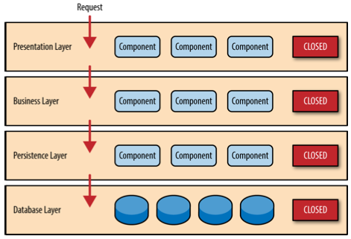
Layered Pattern
Solution
Further reading

Slide 16
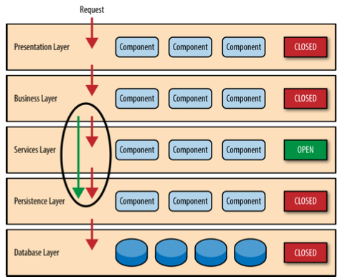
Layered Pattern
Solution
Divides software into units called layers
Each layer is a grouping of modules that offers a cohesive set of service
Relationships between layers must be unidirectional
Layer is only allowed to use public facilities provided by adjacent lower layer
Layer bridging: higher layer uses modules in a nonadjacent lower layer
Bad idea to have many layer bridging

Slide 17
Outline
Introduction
Typical patterns
Module pattern
Component-and-Connector patterns
Allocation patterns
Relationships between tactics and patterns
Using tactics together

Slide 18
Broker Pattern: Context
Many systems are constructed from a collection of services distributed across multiple servers
Many complex software systems run on multiple processors or distributed computers
Distributed system can take advantage of computing power of multiple CPUs or a cluster of low-cost computers
Certain software may only be available on specific computers
Parts of software may have to run on different network segments due to security considerations
Some services may be provided by business partners and may only be accessed over Internet

Slide 19
Broker Pattern: Problem
How to structure a distributed system so that application developers don't have to concern details of remote communication?
Invoke service without knowing whether it is provided locally or remotely
Remote servers can be added, removed, changed at run time
Remote servers can be deployed behind firewall
…
Class discussion: How to satisfy the above requirements?

Slide 20
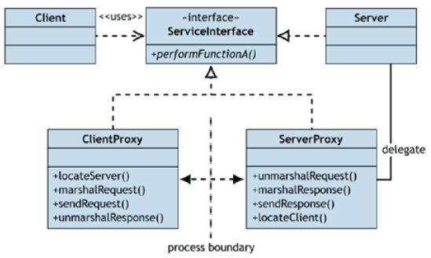
Broker Pattern: Solution 1/7
Service interface: a necessary abstraction that makes distribution possible
Providing contract about service that server is going to provide without exposing implementation details on server side
Client would simply invoke method on client proxy as if it were a local call because client proxy implements ServerInterface

Slide 21
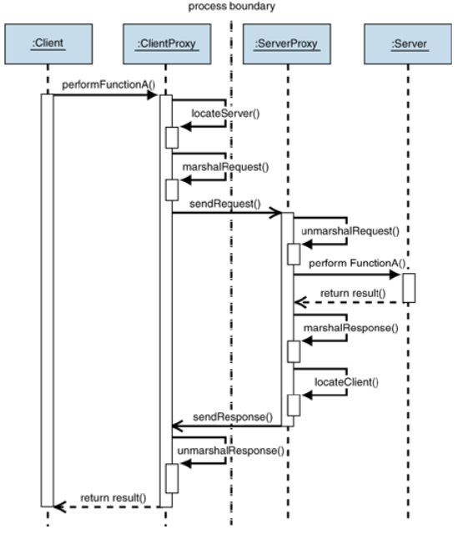
Broker Pattern: Solution 2/7
Client must be able to find location of server at compile time because client proxy communicates with server proxy directly
Cannot change or move server to a different location at run time

Slide 22
Broker Pattern: Solution 3/7
How to avoid exposing exact location of server ?
Deploy a new component, the broker component, at a well-known location and then expose that location to client
Broker is responsible for locating server for client
Broker also implements a repository for adding and removing server components, which makes it possible to add, remove, or exchange server components at run time

Slide 23
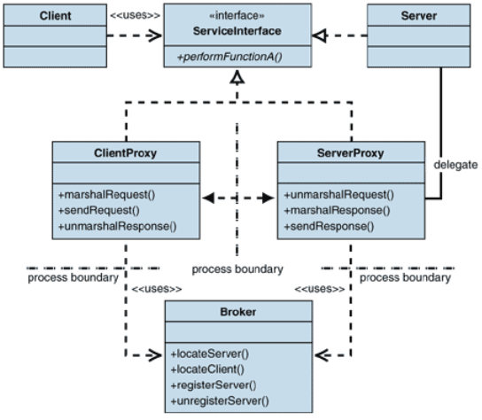
Broker Pattern: Solution 4/7
Broker provides naming service

Slide 24
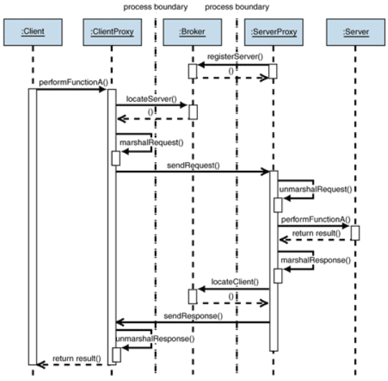
Broker Pattern: Solution 5/7
Activated server registers itself with broker
Registering multiple identical server components will increase performance and availability
In some situations, direct communication between client and server is not desirable
Example: host all servers behind firewall

Slide 25
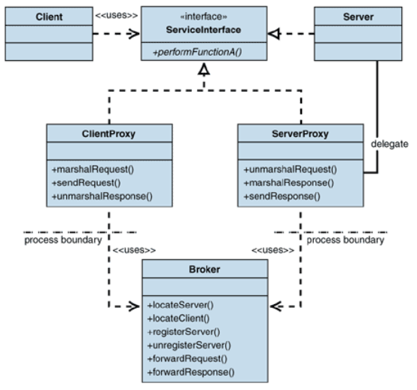
Broker Pattern: Solution 6/7
Broker as intermediary: broker forward all requests and responses between server and client

Slide 26
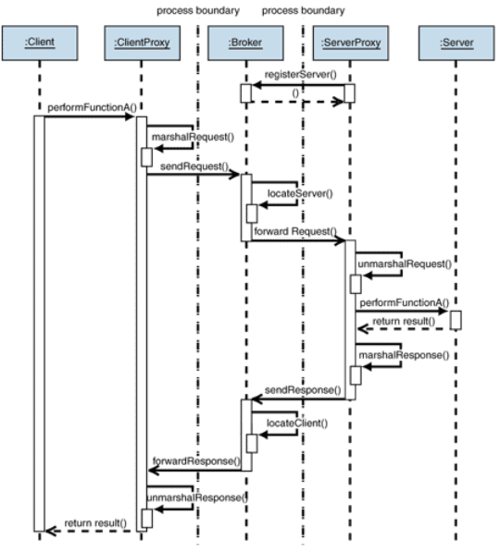
Broker Pattern: Solution 7/7
Broker serves as a messenger between client the server
Further reading

Slide 27
Model-View-Controller Pattern 1/2
Context
User interface is typically the most frequently modified portion
Representation of data should not affect data itself
Problem
How to separate user interface from application functionality?
How can multiple views of user interface be created, maintained, and coordinated when data changes?

Slide 28
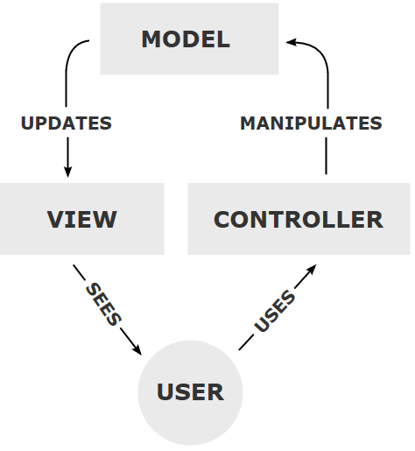
Model-View-Controller Pattern 2/2
Solution: Break system functionality into three components
Model, which contains data
View, which displays some portion of data and interacts with user
Controller, which mediates between model and view and manages notifications of state changes
Both view and controller depend on model. However, model depends on neither view nor controller

Slide 29
Pipe-and-Filter Pattern 1/5
Context
Many systems are required to transform streams of discrete data items from input to output
Many types of transformations occur repeatedly in practice, and so it is desirable to create these as independent, reusable parts
Problem
How to divide system into reusable, loosely coupled component with simple, generic interaction mechanisms?
How to make independent component execute in parallel?

Slide 30
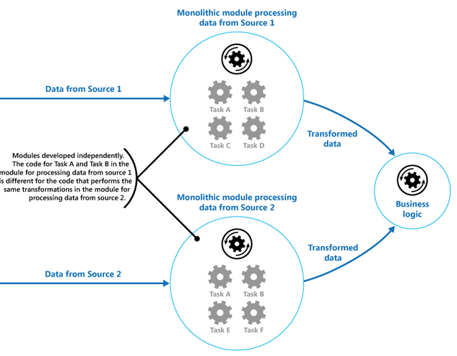
Pipe-and-Filter Pattern 2/5
Data is processed by a separate module
Example
Some tasks are similar and closely coupled within module
Receive and process data from two source

Slide 31
Pipe-and-Filter Pattern 3/5
Solution
Filter: Component that transforms data read on its input to data written on its output
Pipe: Connector that conveys data from a filter’s output to another filter’s input
Provides opportunities for running parallel instances of slow filters
Pipes buffer data during communication so that filters can execute asynchronously and concurrently
Filter does not know identity of its upstream and downstream filters

Slide 32
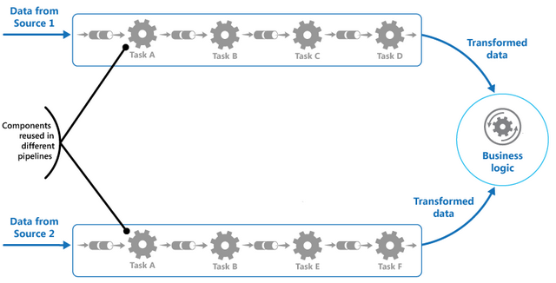
Pipe-and-Filter Pattern 4/5
Solution

Slide 33
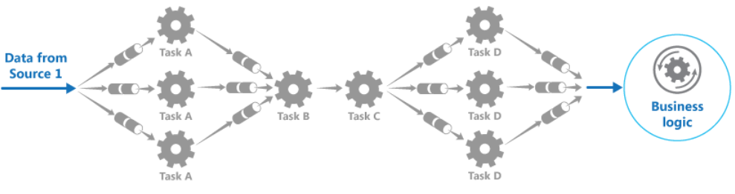
Pipe-and-Filter Pattern 5/5
Solution
Further reading

Slide 34
Peer-to-Peer Pattern 1/2
Context
Each distributed computational entities is considered equally important in terms of initiating an interaction
Question
How to connect a set of equal distributed entities via a common protocol so that they can organize and share services with high availability and scalability?

Slide 35
Peer-to-Peer Pattern 2/2
Solution
Components directly interact as peers
All peers are equal
No peer or group of peers can be critical for the health of system
Each peer component is both a client and a server
Each peer provides and consumes similar services and uses same protocol
Class discussion: advantages and disadvantages of peer-to-peer pattern

Slide 36
Service-Oriented Architecture Pattern
Application components provide services to other component via a communications protocol
A service is a self-contained unit of functionality, it may be discretely invoked
Services can be combined to provide functionality of a large software application

Slide 37
SOA: Context
Service consumers need to be able to understand and use these services without any detailed knowledge of their implementation

Slide 38
SOA: Problem
How can we support interoperability of distributed components
running on different platform
written in different implementation languages
provided by different organizations
distributed across the Internet
How can we locate services and combine them into coalitions while achieving performance, security, and availability

Slide 39
SOA: Solution 1/2
Describes a collection of distributed components that provide and/or consume services
Services are largely standalone: service provides and service consumers are usually deployed independently
Components have interfaces describing services that they provide and request
Components achieve computation by requesting services from one another

Slide 40
SOA: Solution 2/2
Service invocation can be mediated by an Enterprise Service Bus (ESB)
ESB promotes interoperability, security and modifiability
ESB hurts performance, and introduces an additional point of failure
Service registry can be used to improve system modifiability by hiding location and identity of service provider
Orchestration server can be used to improve modifiability, interoperability and reliability for well-defined workflow

Slide 41
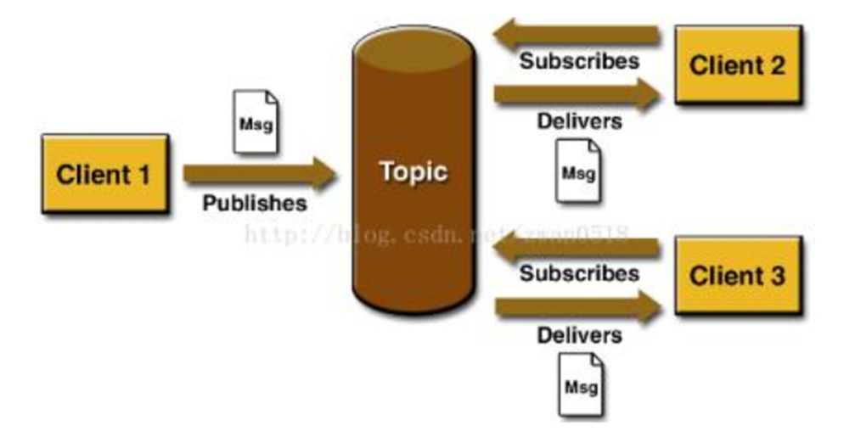
Publish-Subscribe Pattern 1/3
Components publish and subscribe to events
When an event is announced by a components, connector infrastructure dispatches event to all registered subscribers
Extension of observer pattern

Slide 42
Publish-Subscribe Pattern 2/3
Context
A number of independent producers and consumers of data must interact without knowledge of
precise number and nature of data producers and consumers
shared data
Problem
Create integration mechanisms that support ability to transmit messages among producers and consumers without being aware of each other’s identity

Slide 43
Publish-Subscribe Pattern 3/3
Solution
Components interact via announced events
Components may subscribe to a set of events
Advantages
Loose coupling: publishers and subscribers are allowed to remain ignorant of system topology
Scalability: provides opportunity for better scalability through parallel operation, message caching, tree-based or network-based routing

Slide 44
Outline
Introduction
Typical patterns
Module pattern
Component-and-Connector patterns
Allocation patterns
Relationships between tactics and patterns
Using tactics together

Slide 45
Map-Reduce Pattern
Context
Large-scale data processing, at petabyte scale
Programs for analysis of this data should be easy to write, run efficiently, and be resilient with respect to hardware failure
Problem
How to sort and analysis data with ultra-large data set?

Slide 46
Map-Reduce Pattern: Solution 1/2
Using a large number of computers to process parallelizable problems across large datasets
Requires three parts
A specialized infrastructure takes care of allocating software to hardware nodes in massively parallel computing environment
map() function: run on each item in set
reduce() function: run for each unique key emitted by map()

Slide 47
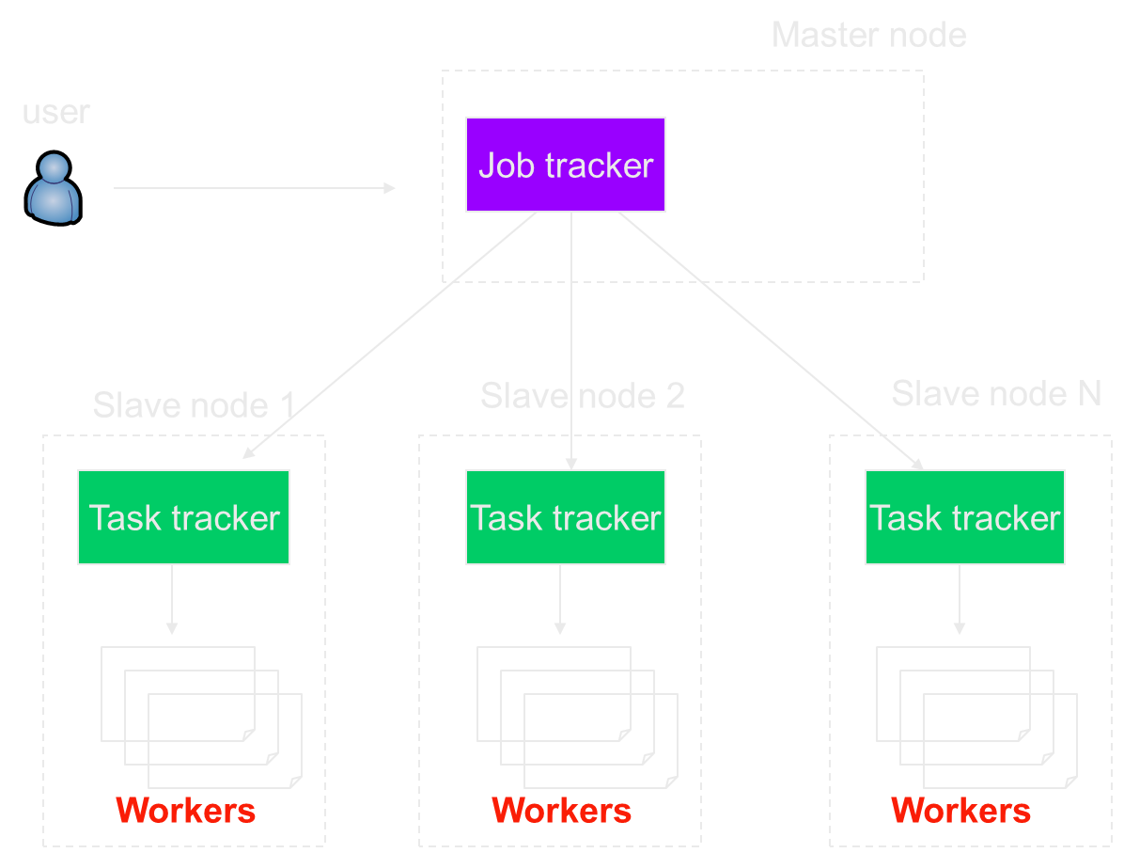
Map-Reduce Pattern: Solution 2/2
Architecture overview

Slide 48
Map-Reduce Pattern: Example 1/2
Counting words in a large set of documents
map(string value)‏
//key: document name
//value: document contents
for each word w in value
EmitIntermediate(w, “1”);
reduce(string key, iterator values)‏
//key: word
//values: list of counts
int results = 0;
for each v in values
result += ParseInt(v);
Emit(AsString(result));

Slide 49
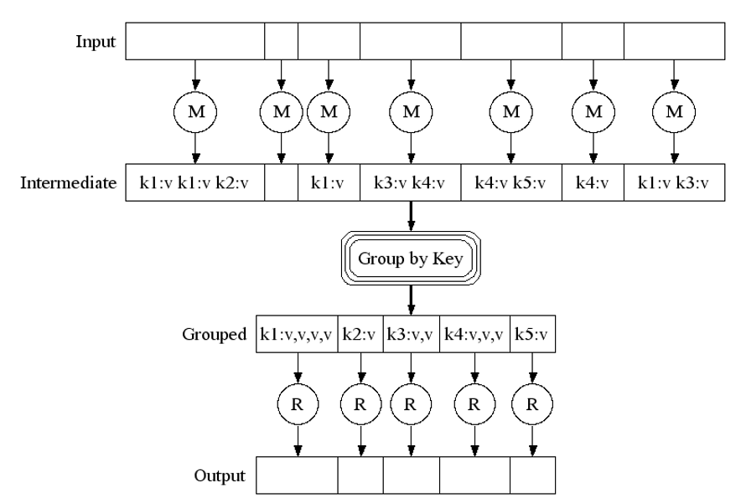
Map-Reduce Pattern: Example 2/2

Slide 50
Map-Reduce Pattern: Advantages
Map-reduce provides
Automatic parallelization & distribution
Fault tolerance
I/O scheduling
Monitoring & status updates

Slide 51
Map-Reduce Pattern: Fault Tolerance 1/3
Worker failure
Heartbeat, workers are periodically pinged by master
No response = failed worker
If a worker fails, its tasks are reassigned to another worker
Master failure
Master writes periodic checkpoints
Another master can be started from last check-pointed state

Slide 52
Map-Reduce Pattern: Fault Tolerance 2/3
Redundant execution
Problem of “stragglers” (slow workers)
Other jobs consuming resources on this machine
Bad disks with soft errors transfer data very slowly
…
When computation almost done, reschedule in-progress tasks
Whenever either primary or backup executions finishes, mark it as completed

Slide 53
Map-Reduce Pattern: Fault Tolerance 3/3
Input error: bad records
Best solution is to debug & fix, but not always possible
On segment fault
Send UDP packet to master
Include sequence number of record being processed
Skip bad records
If master sees two failures for same record, next worker is told to skip the record

Slide 54
Outline
Introduction
Typical patterns
Relationships between tactics and patterns
Using tactics together

Slide 55
Patterns Comprise Tactics
Most patterns consist of several different tactics
Example: Layered pattern
Increase semantic coherence
Responsibilities with semantic coherence are allocated in same layer, thus reliance on other layers is reduced
For example, hardware responsibility and application are in different layer
Restrict dependencies
Layer is only allowed to use services of its adjacent lower layer
Easy to limit side effects of replacing a layer
Without this tactics, any function in any layer can call any other function in any other layer, destroying low coupling between layers

Slide 56
Using Tactics to Augment Patterns
A pattern is described as a solution to a class of problems in a general context
When a pattern is applied to some application, its context becomes very specific
How to make pattern work in a given context?
The inherent quality attribute tradeoffs that the pattern makes
Other quality attributes that the pattern isn’t directly concerned with, but important in target application

Slide 57
Example: Broker Pattern
Weaknesses of the broker pattern:
Availability: Single point of failure
Performance: Levels of indirection between client and server is a potential performance bottleneck
Testability: Brokers are employed in complex and dynamic system, which makes testing and debugging extremely difficult
Security: No authenticate or authorize

Slide 58
Improve Broker Pattern
How to overcome weakness of broker pattern by tactics?
Using multiple brokers to improve performance/availability (increase available resources, performance tactic)
Maintain multiple copies tactic would allow brokers to share state, to ensure that they respond identically to client requests
Load balancing (scheduling resources tactics) would ensure that one broker is not overloaded while another one sits idle
Heartbeat, exception detection, or ping/echo would provide a means of detecting faults
Class discussion: broker pattern and tactics

Slide 59
Outline
Introduction
Typical patterns
Relationships between tactics and patterns
Using tactics together

Slide 60
Using Tactics Together
Tactics are design primitives aimed at managing a single quality attribute response
Every tactic has its side effects
Improving one quality attribute will endanger some others
How to make negative effects acceptable?
Adding other tactics can bring relief and put you back in an acceptable design space

